Slide 1
SOS
Smart Emergency Response & First Aid System
Save Our Souls
A mobile app and website within a complete first aid course · Graduation Project
SOS · 1 / 18

Slide 2
Act in the first minutes, so life lasts until the hospital.
Our Goal
Correct first aid keeps a patient alive and reduces complications until professional care arrives.
SOS · 2 / 18

Slide 3
Project Overview
03
Mobile App
Backend & APIs
Flutter
Node.js · TypeScript
Database
Egypt Numbers
PostgreSQL
One-tap dialer
First Aid & CPR
Cybersecurity
Guides and videos
Pentesting and hardening
Software only
No embedded hardware
SOS · 3 / 18

Slide 4
The Ambulance SOS Button
04
Our main goal
One tap to call the ambulance. The heart of the system.
Always ready
Opens the phone dialer with the number ready. Works without internet.
Backed by first aid
Guides and CPR support the patient until help arrives.
SOS · 4 / 18

Slide 5
Egypt Emergency Numbers
05
123 · Ambulance
180 · Fire Department
122 · Police
126 · Tourist Police
129 · Natural Gas
121 · Electricity
The ambulance is our main goal. The other numbers are general knowledge, each opening the dialer in one tap.
16000 · Child Helpline
15115 · Women’s Helpline
SOS · 5 / 18

Slide 6
Emergency SOS Flow
06
1 · Press SOS
2 · Choose type
The user taps the SOS button.
Select the kind of emergency.
3 · Send to server
4 · Confirmation
The request is sent to the system.
“Your emergency request has been received.”
Status lifecycle
New
Received
Processing
Ambulance dispatched
Resolved
SOS · 6 / 19

Slide 7
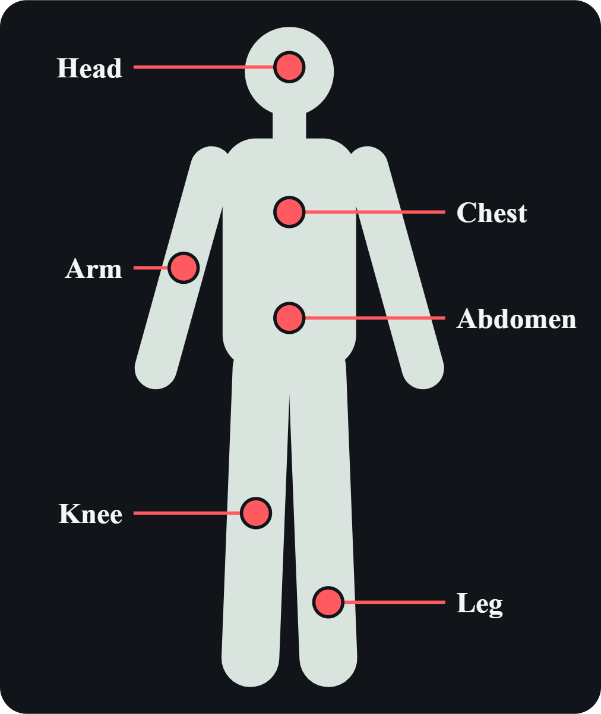
Interactive Body Map
06
1 · Tap the area
Select the injured or painful part of the body.
2 · Read the guide
Clear, step-by-step first aid instructions.
3 · Watch the video
A demonstration of the correct technique. Try the live demo
SOS · 6 / 18

Slide 8
First Aid Guide
07
Burns
Bleeding
Choking
Fractures
Fainting
Seizures
Each condition includes a description, symptoms, first aid steps, video, voice instructions, what NOT to do and when to call emergency.
Heart Attack
Cardiac Arrest
SOS · 7 / 18

Slide 9
CPR Emergency Mode
08
1 · Check responsiveness
Is the person responding and breathing?
2 · Call emergency
Call the ambulance immediately.
3 · Start chest compressions
Push hard and fast until help arrives.
Supported by voice guidance, a timer, a metronome and visual instructions.
SOS · 8 / 18

Slide 10
Medical Video Library
09
Online
Long, detailed lessons with the full library available.
Offline
Short clips saved to watch without internet.
Every situation
Burns · Fractures · Choking · Cardiac arrest and more.
SOS · 9 / 18

Slide 11
Training Mode & Quiz
10
Learning
Short lessons and information about first aid.
Scenarios
Someone is bleeding heavily, what do you do? Pick an answer and the system evaluates it.
Quiz results
Score, correct and wrong answers, with explanations.
SOS · 10 / 18

Slide 12
Daily Learning Notifications
11
A new lesson daily
A daily notification invites you to learn something new.
A small habit
A few minutes a day builds knowledge that can save a life.
Gentle reminders
Keeps you connected to the course, effortlessly.
SOS · 11 / 18

Slide 13
System Architecture
12
Mobile App
Flutter
Backend & APIs
Node.js · TypeScript · REST
PostgreSQL
Only the backend touches the database
Security layer
JWT · RBAC · HTTPS · Rate limiting · Audit logs
Emergency numbers
Open the phone dialer directly, no backend needed
SOS · 12 / 18

Slide 14
Security & Database
13
Security measures
JWT · Password hashing · RBAC · HTTPS · Input validation · Rate limiting · Access control · Audit logs
Database · PostgreSQL
Users · Emergencies · Conditions · FirstAidSteps · Training · Questions · QuizResults
SOS · 13 / 18

Slide 15
MVP: First Shippable Version
15
Mobile
Login · Home · First aid guide · Emergency SOS · Emergency numbers
Backend
Authentication · Emergency API · First aid API · Database
The first version works end to end, from mobile to backend.
SOS · 15 / 19

Slide 16
After the MVP: Roadmap
16
CPR Mode
Voice Guidance
Training Scenarios
Silent SOS
Push Notifications
Analytics
Advanced Security
Arabic / English & Offline Mode
Emergency Contacts
SOS · 16 / 19

Slide 17
Certificate & Pricing
17
Premium certificate
A first aid certificate for those who want one.
Symbolic pricing
Affordable access for anyone who wants the content.
Wide reach
Helping as many people as possible at minimal cost.
SOS · 17 / 19

Slide 18
Why SOS Stands Out in Egypt
18
Simple and accessible
Clear content designed for every age and background.
Everything in one place
Lessons, videos, quizzes and a certificate together.
Ready in an emergency
An SOS ambulance button and offline videos for when it counts.
SOS · 18 / 19

Slide 19
Thank You
SOS · Emergency Response & First Aid System
Ahmed · Tomas · Marina Ramzy · Basmala · Kerolos Ashraf · Jana · Marina Nady · Farah · Abram · Beshoy Emad · Kerolos Ibrahim
SOS · 19 / 19

